Slide 1

JavaScript

Slide 2
About JavaScript
JavaScript is a programming language initially designed to interact with elements of web pages. In web browsers, JavaScript consists of three main parts:
ECMAScript provides the core functionality.
The Document Object Model (DOM) provides interfaces for interacting with elements on web pages.
The Browser Object Model (BOM) provides the browser API for interacting with the web browser.

Slide 3
About JavaScript
When a web page is loaded, i.e., after HTML and CSS have been downloaded, the JavaScript engine in the web browser executes the JavaScript code. The JavaScript code then modifies the HTML and CSS to update the user interface dynamically. The JavaScript engine is a program that executes JavaScript code. In the beginning, JavaScript engines were implemented as interpreters. However, modern JavaScript engines are typically implemented as just-in-time compilers that compile JavaScript code to bytecode for improved performance. The browser has an embedded engine sometimes called a “JavaScript virtual machine”. Different engines have different “codenames”. For example: -> V8 – in Chrome, Opera and Edge. -> Spider Monkey – in Firefox. -> There are other codenames like “Chakra” for IE, “JavaScript Core”, “Nitro” and “Squirrelfish” for Safari, etc.

Slide 4
Internal JS & External JS
Internal JS:
<script type="text/javascript">
Write your JavaScript code here..
</script>
External JS:
<script type="text/javascript" src=“./index.js"> </script>
Note:
Notice the minute difference in importing both the external and Internal JS
It’s better to keep it at the end of the body tag to improve the performance.

Slide 5
Variables
A JavaScript variable is simply a name to store values.
Name must start with a letter (a to z or A to Z), underscore( _ ), or dollar( $ ) sign.
After first letter we can use digits (0 to 9) and anything from 1st point.
Correct JavaScript variables
var cost = 10;
var _name=“Amit";
Incorrect JavaScript variables
var 123=30;
var A*aa=320;

Slide 6
Console.log()
The log() method writes (logs) a message to the console.
The log() method is useful for testing purposes.
Example1:
console.log("Hello world!");
Example2:
let a = 25;
console.log(“The value of a is:", a );
( ) | Parentheses | round brackets | first brackets
{ } | Braces | curly brackets | second brackets
[ ] | Brackets | square brackets | third brackets
⟨ ⟩ | Chevrons | angle brackets

Slide 7
Primitive (simple) Data Types
JavaScript variable can hold different types of data, also know as data-types.
There are two types of data types in JavaScript: Primitive and Non-Primitive.
Primitive Data Type | Description
String | represents sequence of characters (text) e.g. "hello"
Number | represents numeric values e.g. 100
Boolean | It store either true( 1, 3, true, “string”) or false (-4, 0, false)
Undefined | It means a variable has been declared but has not (initialized) yet been assigned a value. The typeof undefined => undefined. It is used by browsers. If we performing primitive operations, we will get NaN (not a number).
Null | It can be assigned to a variable which indicates intentional absence of value. The typeof null => object. It is used by developer Null is converted to zero (0) while performing primitive operations.
IQ. What is the difference between Null & Undefined?

Slide 8
Non Primitive (complex) Data Types
Data Type | Description
Object | represents instance through which we can access members
Array | represents group of items that can be accessed using its index number.
Regular Expression | A regular expression is a sequence of characters that forms a search pattern.
. const person = {
name :“Sweeta",
age:“21",
mobile:“980292345“
};
const colors = [ “red”, “green”, “blue”, 123];
const text = "Visit W3Schools!"; const n = text.search("W3Schools"); //6 /w3schools/i

Slide 9
JS Arithmetic Operators
Operator | Description | Example
+ | Addition | 10+20 = 30
- | Subtraction | 20-10 = 10
* | Multiplication | 10*20 = 200
/ | Division | 20/10 = 2
% | Modulus (Remainder) | 20%10 = 0
++ | Increment | var a=10; a++; Now a = 11
-- | Decrement | var a=10; a--; Now a = 9

Slide 10
JS Comparison Operators
Operator | Description | Example
== | Is equal to | 10+20 = 30
=== | Identical (equal and of same type) | 20-10 = 10
!= | Not equal to | 10*20 = 200
!== | Division | 20/10 = 2
> | Modulus (Remainder) | 20%10 = 0
>= | Increment | var a=10; a++; Now a = 11
< | Decrement | var a=10; a--; Now a = 9
<=

Slide 11
Case Sensitivity
JavaScript is a case-sensitive language.
This means that the variables name, function names, etc. must be consistent capitalization of letters.
Example:
let name = “Atul”
let naMe = “Kapil”
Here “name” and “naMe” are different variables.
Camel Case Notation:
In JavaScript we generally follow camel case notation to name our variables and function. Where the first letter of the first word start in small case and the first letter of the second word start in capital letter.
Example:
let fullName = “your name”
function addAndConsole(){ …. }

Slide 12
Comments in JS
Option:1 // single line comment
Option:2 /*
multiple
lines
comment
*/
Shortcut to comment out a code: first select the code and then press ctrl + /
IQ. What is the use of comments in programming?
We write comments to explain our intent to other developers.
We use comments for debugging and testing purpose.
We can also use comments as documentation of a feature or functionality.
Sometimes we comment a section, if it is possible to rollback in future.

Slide 13
Dynamic typed language
JavaScript is a dynamic type language, means a variable can store one data type and later it can also store a different data type.
For example:
var name ="Rahul"; //initially it is holding string
typeof name; //string
name =40; // now it is holding number
typeof name; //number

Slide 14
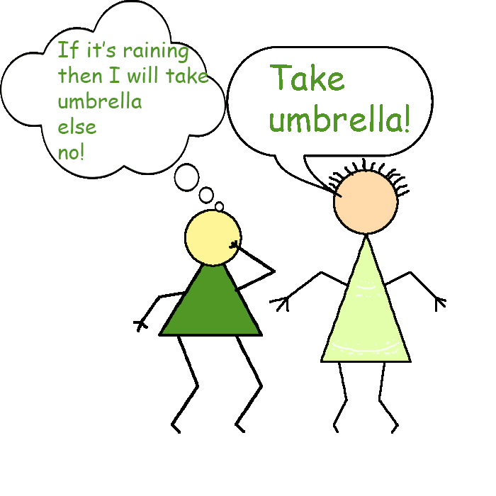
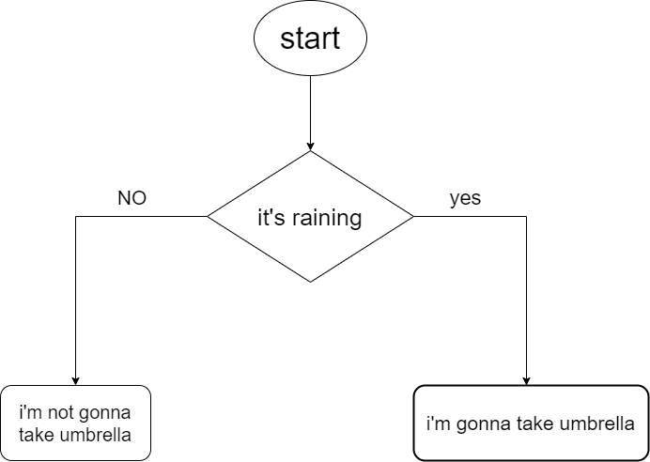
If else condition (0/3)
The JavaScript if-else statement is used to execute the code depending on whether the condition is true or false.
Examples:
The JavaScript if-else statement is used to execute the code depending on whether the condition is true or false.
Examples:

Slide 15
If condition (1/3)
If the expression is true then code inside the if block is executed else it skip or ignore the code inside the if block.
Syntax:
if(expression){ //expression == condition
//content to be evaluated 1
//content to be evaluated 2
}
Example:
var a = 20;
if( a > 10 ){ //true
console.log("value of a is greater than 10");
}

Slide 16
If-else condition (2/3)
If the expression is true then code inside the if condition is executed else it executes the else code.
Syntax:
if(expression){
//content to be evaluated if condition is true
} else {
//content to be evaluated if condition is false
}
Example:
var a=20;
if(a>10){
console.log("value of a is greater than 10");
} else {
console.log(“else is getting executed”);
}
Extra: expressions with && operator and || operator.

Slide 17
If-else-if condition (3/3)
It checks each expression from top, whichever expression is true it executed that code block and skips the rest of the code. If none of the expression is true then it executes the else code.
Syntax:
if(expression1){
//content to be evaluated if expression1 is true
}
else if(expression2){
//content to be evaluated if expression2 is true
}
else if(expression3){
//content to be evaluated if expression3 is true
}
……
else{
//content to be evaluated if no expression is true
}
Problem : Writing multiple else if statements is not always the best solution, especially when all of the branches depend on the value of a single variable.

Slide 18
Switch Case
The switch statement is used to perform different actions based on different conditions.
Syntax:
switch (expression) {
case condition 1: statement(s)
break;
case condition 2: statement(s)
break;
case condition n: statement(s)
break;
default: statement(s)
}
IQ. Why do we use break statement in switch case?
The break statement "jumps out" of a switch case or a loop.
The default keyword specifies the code to run if there is no case match:
Example:
var grade = ‘B';
switch (grade) {
case 'A': console.log(“Very Good");
case 'B': console.log(“Good");
case 'C': console.log("Passed");
case 'F': console.log("Failed");
default: console.log("Unknown grade")
}

Slide 19
Loop
We use loop to execute a block of code again and again until the expression is false.
The loop must have a terminating condition to avoid infinite loop.
Real life example: Listening to your fav music in loop.
There are mainly three types of loop.
for loop
while loop
do-while loop
Other then these three we have a couple of other loops, introduced with JS ES6 version like .map(), .filter(), .forEach(), etc.

Slide 20
for loop
Syntax:
for (expression 1; expression 2; expression 3) {
// code block to be executed
// fav music
}
Execution sequence:
for (step 1; step 2; step 3) {
// code body
}
1 => 2 => code => 3
2 => code => 3
2 => code => 3
It will continue to repeat the process unless and until step 2 (expression 2) is false. Hence our terminating condition is written in expression 2. Also, expression 1 is executed only once.

Slide 21
IQ: while loop & do while loop
while loop:
Syntax:
while (condition) {
// code to be executed only if
// above condition is true
}
Example1:
var i=1;
while (i<=5) {
console.log(i);
i++;
}
Example2:
while (exam != tomorrow) {
console.log(“No study…still I have time“);
}
do while loop
Syntax:
do {
// code to be executed at least
// once regardless of the
// condition & runs until it is false.
} while (condition);
Example1:
var i=1;
do{
console.log(i);
i++;
} while (i<=5)
Example2:
You have to try the food once before you can decide if the restaurant food is good or not. Similarly test-driving.

Slide 22
Functions
A function is a group of reusable code which can be called anywhere in your program. This eliminates the need of writing the same code again and again.
Functions allow a programmer to divide a big program into a number of small functions that are easy to understand and manage.
Function Definition:
function funName(){
//code to be executed
//code to be executed
}
Calling a Function: A function gets execute only if we call it. Eg:
funName()
Function parameters:
function myFunction(a, b) {
return a * b;
}
myFunction(4, 3);
Function Return: The values that we get as a result after calling that function.

Slide 23
Functions - type
Anonymous function: If a function don’t have a name then we called it anonymous function. function() { return a * b; }
Functions Expressions: If we store an anonymous function in a variable, it is called function expression. let result = function(a, b) { return a * b; } result(4, 3); //calling the anonymous function
Arrow functions class component (this), functional const x = (x, y) => x * y;
Self-Invoking Anonymous function: functions that call themselves, we don’t need to call them. (function () { console.log(“I don’t need to be called”); })();

Slide 24
Arrow Functions
Arrow functions were introduced in ES6.
Arrow functions allow us to write shorter function syntax:
const sum = (x, y) => {
return ( x + y );
}
For single line of code, you don’t need parentheses and return keyword.
const sum = (x, y) => x + y;
If you have only one parameter, you can skip the parentheses as well:
const print = name => console.log(“hello” + name);

Slide 25
Recursion function:
A function is recursive if it calls itself again and again until it reaches a stop condition.
var i = 0; function multiply(){ i++ console.log("mutipley function called", i) //logs 5 times, 1 to 5. if(i == 5){ console.log("inside if condition, the value of i is", i); //logs only once return; // terminating condition - return out of the multiply function }
multiply();
console.log("Getting executed 4 times, once recursion is over", i);
}
multiply();
console.log("came out of the Recursion function finally");

Slide 26
Nested Arrays
const nestedArr = [ [1,2,3], [4], [7,8, [0, 2, 0], 9] ];
// console.log(nestedArr[1]);
for(let i=0; i<nestedArr.length; i++ ){
if(i == 2){
// console.log(nestedArr[i]);
}
for(let j=0; j<nestedArr[i].length; j++){
// console.log(nestedArr[i][j]);
for(let k=0; k<nestedArr[i][j].length; k++){
// console.log(nestedArr[i][j][k]);
}
}
}

Slide 27
Nested Arrays
const mixData = {
characters: [
{
name: "Amit1",
age: 22
},
{
name: "Amit2",
age: 24
} ] }
Paranthese () – Round brackets.
Curly braces {}
Square brackets []

Slide 28
Array Methods – .map()
.map()
map is an Array helper methods that help us to look through an Array.
map calls a function once for each element in an array.
map creates a new array from calling a function for every array element.
const allStudents = [
{
class: 10,
batchYear: "2022-2023",
section1: [
{ id: 22, name: "sensor1", fee: 300 },
{ id: 33, name: "sensor2", fee: 300 } ] ,
section2: [
{ id: 2, name: "sensor3", fee: 300 },
{ id: 3, name: "sensor4", fee: 300 } ] ,
}
];
Q. Create a new array that contains all the names of class 10 students.
const result = allStudents.map(element => element.section2.map(s => s.name) );
console.log(result);

Slide 29
Array Methods – .forEach()
.forEach()
forEach method is an Array helper method that helps us to loop through an Array.
The forEach method calls a function for each element in an array.
The forEach method is not executed for empty elements.
const allStudents = [
{
class: 10,
batchYear: “2022-2023",
children1: [
{ id: 2, name: "sensor1", fee: 300 },
{ id: 3, name: "sensor2", fee: 300 } ] ,
children2: [
{ id: 2, name: "sensor3", fee: 300 },
{ id: 3, name: "sensor4", fee: 300 } ] ,
},
{…}
];
Q. Display all the names of class 10 students.

Slide 30
IQ. forEach() vs map()
The forEach() method returns undefined and map() returns a new array with the transformed elements.
Example: const myArr = [1, 2, 3, 4]
myArr.forEach(x => x * x) >>>>>>>>> return value: undefined
myArr.map(x => x * x) >>>>>>>>> return value: [1, 4, 9, 16]
forEach() updates the actual array and .map() never modify the actual array.
Q. When we should use one or the other?
You should pick map(), because it returns a new array with the transformed data.
But, if you won't need the returned array, don't use map() or want to update the actual array then use forEach(), similar to a for loop.

Slide 31
Hoisting
JavaScript Hoisting refers to the process whereby the interpreter appears to move the declaration of functions, variables or classes to the top of their scope, prior to the execution of the code.
logName("Dipak"); //Hello Dipak
function logName(name){
return "Hello " + name;
}
console.log(num); //Undefined
var num = 10;
And it seems like arrow functions and variables with let and const are not hoisted.

Slide 32
How JS get Executed
To execute a JS file browser create an environment called global execution context(GEC). To execute a function inside a JS file, it create a new EC inside the GEC. The code is executed in two phases, in the first phase is called memory creation phase, here memory is allocated for each variable(undefined) and function (function definition). The second phase is called code execution phase where the code is executed line by line from top to bottom. Here variable values are updated with actual value. Function are executed in a new execution context.
var dx = 12;
function doubleFun(num){
var result = num*2
return result;
}
var double33 = doubleFun(33);
console.log(“hello”);
Memory Creation Phase dx : undefined doubleFun: f doubleFun(num){ var result = num*2 return result; } double33: undefined
Code Execution Phase dx : 12 doubleFun: f doubleFun(num){ var result = num*2 return result; } double33: undefined
Step 1
Step 2

Slide 33
How JS works!
GLOBAL EXECUTION CONTEXT
Code Execution Phase dx : 2
doubleFun: f doubleFun(num){
var result = num*2
return result;
}
double33: undefined
console.log(“hello”);
Memory Creation Phase
num: undefined
result: undefined
Code Execution Phase
num: 33
result: 66
Can we see them in action, somewhere in the browser?

Slide 34
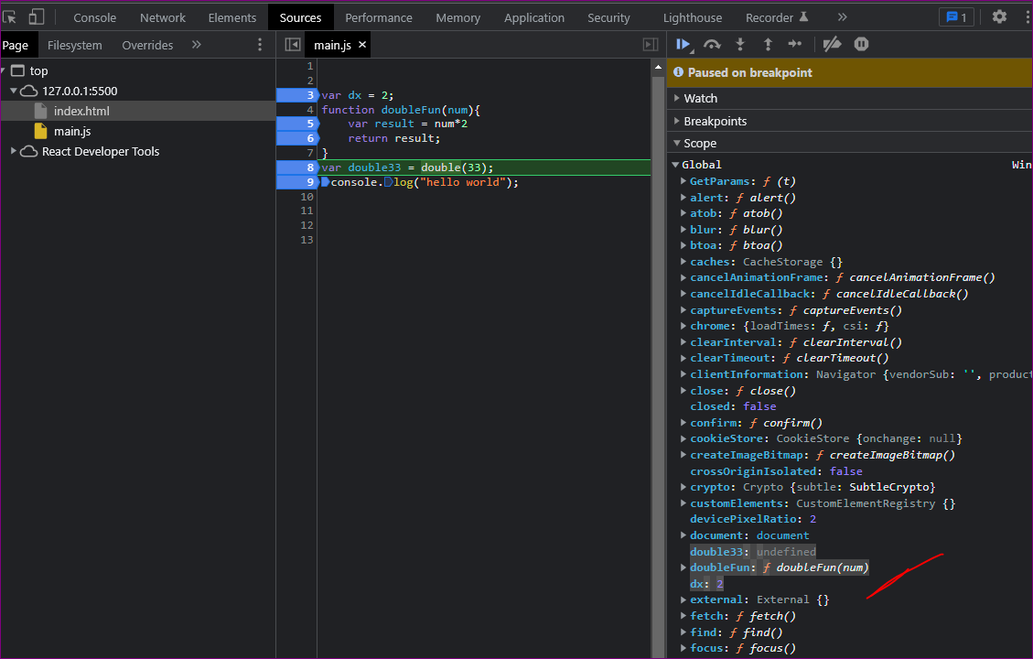
Debugging in Action
Right Click > Inspect > Sources > Find your JS file and put few “breakpoints”.
Now you can see the values of different variable and its scope at that breakpoints.
Main Features of Source file debugging:
Resume script execution
Deactivates breakpoint
Local EC or (Function EC)
GEC or (anonymous)
Call Stack

Slide 35
Call Stack in JS
Call Stack maintain the order of execution of execution context(EC).
Call Stack is also know as:
Execution Context Stack
Program Stack
Control Stack
Runtime Stack
Machine Stack
JS file may have nested functions, which basically means the browsers compiler will have create and delete multi-layer of EC. To keep a track of these EC, we have call stack.
Each EC is deleted once the function is returned. Even the global EC is also deleted at the end once all the code in JS file is executed.
doubleFun
GEC

Slide 36
Hoisting: let, const & Arrow()
Arrow function are not hoisted because they behave similar to a variable (stores undefined as value in global object) and we are try to call it like a function.
logName(); //Uncaught type Error: logName is not a function
var logName = () => {
return "Hello”;
}
Variables with let and const are not hoisted because they are allocated memory in script object instead of global object.
console.log(num); //Reference Error: “cannot access “num” before initialization”
// Reference Error: “num” is not defined.
let num = 10;

Slide 37
Scope
Block Scope : let and const defined inside a block.
Local (Function) Scope : let, var & const defined in a function.
Script Scope : let and const are defined outside of all function. OR var inside a block.
Global Scope : var defined outside the functions. OR variable that are initialized without declared.
var dx = 2;
function doubleFun(num){
var result = num*2
if(true){
const name = “Something";
}
return result;
}
var double33 = doubleFun(33);
console.log("hello world");

Slide 38
Difference b/w var, let & const
 | var | let | const
Scope (accessibility) | Function | Block | Block
Re-assign (change) the value of a variable | Allowed | Allowed | Not allowed
declared without initialization | Allowed | Allowed | Not allowed
Re-declaration of the same variable | Allowed | Not Allowed | Not Allowed
Hoisting- using variable before declaration | Allowed | Not Allowed | Not Allowed
Reference docs: https://www.geeksforgeeks.org/difference-between-var-let-and-const-keywords-in-javascript/

Slide 39
IQ on Scope
Variables with “var” stored in global scope, unless defined in a function.
var a = 10;
{
var a = 20;
console.log(a)
}
console.log(a);
let stored in Script scope, if not defined inside a block or function.
let a = 10;
{
let a = 20;
console.log(a)
}
console.log(a);
Err:
let a = 10;
{
var a = 20;
console.log(a)
}
console.log(a);
let a = 10;
function fun(){
var a = 20;
console.log(a)
}
console.log(a);

Slide 40
Document Object (DOM)
The document object represents the whole html document. => console.log(document);
When html document is loaded in the browser, the entire html page becomes a object called DOM.
This object has built-in methods(getElementById) and properties(innerHTML) that we can use to access a particular html element using below mehods:
Method | Description
document.getElementById(“id”) | Find an element by element id
document.getElementsByTagName(“name”)[0] | Find elements by tag name
document.getElementsByClassName(“name”)[0] | Find elements by class name
Once you access them you can update them.
document.getElementById("demo").innerHTML = "Date : " + Date();
document.getElementsByTagName("p")[0].style.color = "blue";
document.write("Hello World!")
Never use document.write() after the document is loaded. It might overwrite the document.

Slide 41
String Methods
The length property returns the length of a string: let text = "ABCDEFGHIJKLMNOPQRSTUVWXYZ"; let length = text.length; //26
String slice() extracts a part of a string (or Array) and returns the extracted part in a new string. let text = "Apple, Banana, Kiwi"; let part = text.slice(7,17); // slice(from, till)
toUpperCase() and toLowerCase() let text = “The quick brown fox jumps over the lazy dog”; text.toUpperCase();
concat() joins two or more strings: let text1 = "Hello"; let text2 = "World"; let text3 = text1.concat(" ", text2);

Slide 42
Array methods: Slice vs Splice
slice()
The slice array method returns a new cut array from the original array without changing the original array.
Syntax: array.slice(from, till);
Here, till is optional and not included in the new array.
let originalArr = [ "apple", true, [1, 3],
{ type : “fruit“ } ];
let newArr = originalArr.slice(1,3);
console.log(originalArr);
console.log(newArr);
splice()
Splice array method help us to remove add or remove elements to the original array.
Syntax: array.splice(from, deleteCount, newElem1, …, newElem2);
splice() return deleted element. If deleteCount is 0, an empty array would be returned.
let originalArr = ["apple", true, [1, 3],
{ type : "fruit" } ];
let newArr = originalArr.splice(2,1, { cost: "40$" });
console.log(originalArr);
console.log(newArr);

Slide 43
Spread Methods …
slice()
The slice array method returns a new cut array from the original array without changing the original array.
Syntax: array.slice(from, till);
Here, till is optional and not included in the new array.
let originalArr = [ "apple", true, [1, 3],
{ type : “fruit“ } ];
let newArr = originalArr.slice(1,3);
console.log(originalArr);
console.log(newArr);
splice()
Splice array method help us to remove add or remove elements to the original array.
Syntax: array.splice(from, deleteCount, newElem1, …, newElem2);
splice() return deleted element. If deleteCount is 0, an empty array would be returned.
let originalArr = ["apple", true, [1, 3],
{ type : "fruit" } ];
let newArr = originalArr.splice(2,1, { cost: "40$" });
console.log(originalArr);
console.log(newArr);

Slide 44
Ternary operator
A ternary operator evaluates a condition and executes a block of code based on the condition.
Its syntax is:
condition ? expression1 : expression2
Execution Step:
1. The ternary operator evaluates the test condition.
2. If the condition is true, expression1 is executed.
3. If the condition is false, expression2 is executed.
let result = (marks >= 40) ? 'pass' : 'fail';
The ternary operator takes three operands, hence, the name ternary operator. It is also known as a conditional operator.

Slide 45
Template Literals
Template Literals use back-ticks (``) rather than the quotes ("") to define a string: let text = `Hello World!`;
With template literals, you can use both single and double quotes inside a string: let text = `He's often called "Johnny"`;
Template literals allows multiline strings:
let text = `The quick brown fox jumps over the lazy dog`;
Interpolation : Template literals provide an easy way to interpolate variables and expressions into strings. ${...} let firstName = "John"; let lastName = "Doe"; let text = `Welcome ${firstName}, ${lastName}!`;

Slide 46
Callback function
In JavaScript, a callback is a function that’s passed as an argument to a second function.
The function which receives the callback decides if and when to execute the callback:
function myFunction(callback) {
// 1. Do something
// 2. Then execute the callback
callback()
}
function myCallback() {
// Do something else
}
myFunction(myCallback);
Q. Why Do We Need Callback Functions?
JavaScript is single-threaded.
As for higher-order functions, these are simply functions that either take a function as an argument, or return a function as a result. There are several native JavaScript functions that are also higher-order functions, such as setTimeout
console.log('Start')
setTimeout(() => {
console.log("inside");
}, 4000)
console.log('End')

Slide 47
JS functions: First Class Objects
In JS functions can be assigned as values to a variable.
A functon can be defined inside another function.
A function can be returned by a function.
A function can be passed as arguments to another function.
…because of above features JS functions are also called as First class objects or First class citizens.
Also called a callable object.

Slide 48
Everything in JS is Objects
In JavaScript, everything is an object except for the primitive data types (boolean, number, and string), and undefined.
typeof null and array is object.
Eventhough typeof function is function but they are actually callable objects, since we can use new keyword to create an instance(copy) of this function Constructor and type of that variable is obj.
function fun(){
console.log("hii");
}
const newVar = new fun();
typeof newVar; //object

Slide 49
JS this keyword 1/2
this is always a reference to an object.
In global space, this refers to the global object (window object).
console.log("this value: ", this);
In an object method, this refers to that particular object. Not global object. const obj = {
name: “Mr This",
age: 24,
methodLog: function(){
console.log("this value: ", this);
} } obj.methodLog();
In an event, this refers to the element that received the event. <button onclick="this.style.display='none'">Button 1</button> <button onclick="this.style.display='none'">Button 2</button>

Slide 50
JS this keyword 1/2
In a function, this refers to the global object.
But in "use strict"; mode, this is undefined in a function.
var age = 25;
function whoIsThis() {
var age = 30;
console.log("age : " + age); // 30
console.log("this.age : " + this.age); // 25
}
whoIsThis();
In this example, even though we have a variable named age inside the function but “this” is still referring to the outer variable. And if it is not available outside then it returns undefined.

Slide 51
JS class & constructor
A class in JS was introduced in ES6. A class is not an object. It is a template for objects.
class Car {
constructor(name, year) {
this.name = name;
this.year = year;
}
clog(name){
console.log(this.name, "is a nice choice, Mr", name);
}
}
// we can create an object having all the properties and methods of a class using new keyword.
let myCar1 = new Car("Ford", 2014);
let myCar2 = new Car("Audi", 2019); //assigning values to object properties
console.log(myCar1.name, "Model", myCar1.year); //accessing object properties
// you can only access the methods inside a class but can’t call the class directly.
myCar1.clog("dipak")

Slide 52
Constructor Method
The constructor method is a special method of a class for creating and initializing an object instance(copy) of that class.
A class will always have a constructor() method. If you do not define a constructor method, JavaScript will add an empty constructor method.
It is executed automatically when a new object is created. It is used to initialize object properties.
class Person {
constructor(name) {
this.name = name;
}
introduce() {
console.log(`Hello, my name is ${this.name}`);
}
}
const otto = new Person("Atul");
otto.introduce(); // Hello, my name is Atul

Slide 53
Constructor Function
A constructor function is like a normal function, used to create objects. It’s name should start with Capital letter.
function Person (pName, pAge, pGender) {
this.name = pName,
this.age = pAge,
this.gender = pGender,
this.greet = function () {
return ('Hi' + ' ' + this.name);
}
}
const person1 = new Person('John', 23, 'male');
const person2 = new Person('Sam', 25, 'female');
console.log(person1.name); // "John"
console.log(person2.name); // "Sam"
Adding Properties & Methods in an Object:
// adding property to person1 object :
person1.gender = 'male';
// adding method to person1 object
person1.sayHello = function () {
console.log('hello');
}
person1.sayHello(); // hello
person2.sayHello(); // error: person2 doesn't have greet() method

Slide 54
Constructor Function - scope
function Animal(){
var alive=true; // Private property
function fight(){ //... } // Private method : function inside a class is
this.isAlive = function() { return alive; } // Public method which can access private variables
this.name = "Joe"; // Public property
}
Animal.prototype.play = function() { alert("Bow wow!"); } // Public method

Slide 55
Prototype
Every object in JavaScript has a built-in property, which is called its prototype.
const myObject = {
city: "Madrid",
greet() {
console.log(`Greetings from ${this.city}`);
},
};
myObject.greet(); // Greetings from Madrid
This is an object with one data property, city, and one method, greet(). But if you log this object then you will notice that there are lots of other properties and methods available on this object. We can access them using objectName.prototype.methodName()

Slide 56
Prototype chaining.
Every object in JavaScript has a built-in property, which is called its prototype.
The prototype is itself an object, so the prototype will have its own prototype, making what's called a prototype chain.
When you try to access a property of an object:
If the property can't be found in the object itself, the prototype is searched for the property. If the property still can't be found, then the prototype's prototype is searched, and so on until either the property is found, or the end of the chain is reached, in which case undefined is returned.
myObject.toString();
So when we call myObject.toString(), the browser:
Step 1. looks for toString in myObject
Step 2. can't find it there, so looks in the prototype object of myObject for toString
Step 3. finds it there, and calls it.

Slide 57
Synchronous vs Asynchronous
Synchronous
When code is synchronous, it runs from top to bottom, line by line. Operations occur one after another, with each operation waiting for the previous one to complete.
Asynchronous
JavaScript interpreter doesn’t have to wait for the asynchronous operation to complete, it can carry on with other tasks meanwhile this async task will execute parallely and values are displayed after all the sync tasks are returned.
console.log('Start')
setTimeout(() => {
console.log(“Inside");
}, 2000);
console.log('End');
One of the primary examples of an asynchronous function is fetching data from a remote API.

Slide 58
Promises
The Promise object represents the eventual completion (or failure) of an asynchronous operation. At the end of the day a promise is either resolved or rejected. If we want to perform certain task after promise is resolved then we write it in .then(). Similarly if we want to perform certain if it get failed or rejected then we write it inside .catch()
let myPromise = new Promise( (pass, fail) => {
let marks = 30;
if (marks > 40) {
pass("You have passed, successfully");
} else {
fail(“Sorry, try next year")
}
});
myPromise
.then( value => console.log(value))
.catch( err => console.warn(err));

Slide 59
API & Error Handling
The fetch() method starts the process of fetching a resource from a server.
The fetch() method returns a Promise that resolves to a Response object.
fetch('https://jsonplaceholder.typicode.com/users')
.then(response => response.json())
.then(json => console.log(json) ) // promise chaining
.catch(err => console.warn("Error: ",err));
try and catch method:
try {
// block of code to look for error
}
catch(err) {
// block of code to handle errors
}

Slide 60
Objects Destructuring
Object destructuring allows you to create new variables using an object property as the value.
Eg 1:
const note = {
id: 1,
title: 'My first note',
date: '01/01/1970',
}
// Create variables from the Object properties
const id = note.id
const title = note.title
const date = note.date
// Destructure properties into variables
const { id, title, date } = note
console.log(id)
console.log(title)
console.log(date)
Eg 2:
const note = {
id: 1,
title: 'My first note',
date: '01/01/1970',
author: {
firstName: 'Sherlock',
lastName: 'Holmes',
},
}
// Destructure nested properties
const {
id,
title,
date,
author: { firstName, lastName },
} = note
console.log(`${firstName} ${lastName}`)

Slide 61
Array Destructuring
Array destructuring allows you to create new variables using an array item as a value.
Eg 1:
const date = ['1970', '12', '01']
// Create variables from the Array items
const year = date[0]
const month = date[1]
const day = date[2]
// Destructure Array values into variables
const [year, month, day] = date
console.log(year)
console.log(month)
console.log(day)
// Skip the second item in the array
const [year, , day] = date
console.log(year)
console.log(day)
Eg 2:
// Create a nested array
const nestedArray = [1, 2, [3, 4], 5]
// Destructure nested items
const [one, two, [three, four], five] = nestedArray
console.log(one, two, three, four, five);

Slide 62
Spread & rest operators
Mutation in Array and Object. Deep copy and Shallow copy
const obj1 = { a: 1, b: 2 };
const obj2 = obj1; // call by reference
obj1.a = 5;
console.log(obj1) //{ a: 5, b: 2 }
console.log(obj2) //{ a: 5, b: 2 }
const obj3 = { a: 1, b: 2 };
const obj4 = {...obj3}; //deep clone or copy by value
obj3.a = 5;
console.log(obj3) // { a: 5, b: 2 }
console.log(obj4) // { a: 5, b: 2 }
Eg 1:
const date = ['1970', '12', '01']
// Create variables from the Array of items

Slide 63
Mutation
Mutation in Array and Object. Deep copy and Shallow copy
Eg 1:
const date = ['1970', '12', '01']
// Create variables from the Array items
// In Objects - call by reference means it use the same memory, other objects will have a copy of this memory location.
// In primitive - call by value, a new memory is created everytime.
// mutatable = changable.
// immutable = can't change it

Slide 64
Task 1: The Diagonal Sum - Assignment
https://codepen.io/thedipak/pen/NWBVWWx?editors=0010
function diagonalSum(givenArr) {
let isPefectSquare = givenArr.every( (givenInnerArr) => givenInnerArr.length === givenArr.length);
const isNumberArr = givenArr.every((givenInnerArr) => givenInnerArr.every((value) => typeof value === "number") );
if (isPefectSquare && isNumberArr) {
let diagonalASum = 0;
let diagonalBSum = 0;
for (let i = 0; i < givenArr.length; i++) {
for (let j = 0; j < givenArr[i].length; j++) {
if (i == j) diagonalASum += givenArr[i][j]; // console.log(diagonalASum)
if((i+j) == 2) diagonalBSum += givenArr[i][j]; // console.log(diagonalBSum)
}
}
return Math.abs(diagonalASum + diagonalBSum);
} else {
throw "Either its not a perfect square or it contain invalid data";
return 0;
}
}
let givenArr = [
[1, 2, 3], // i=0, j=0 || i=0, j=2
[8, 2, 4], // i=1, j=1 || i=1, j=1
[6, 6, 5], // i=2, j=2 || i=2, j=0
];
diagonalSum(givenArr);

Slide 65
Task 2: Pyramid of Asterisks
https://codepen.io/thedipak/pen/jOpoVLO?editors=0011
// [ 1.Create a matrix 2.Where we need stars 3.col relation with tRows and cRow
// [' ', ' ', ' ', '*', ' ', ' ', ' '] | r = 1; c = 4 | c>=4 && c<=4 | c>=tR-r+1 && c<=tR+r-1
// [' ', ' ', '*', '*', '*', ' ', ' '] | r = 2; c = 3,4,5 | c>=3 && c<=5 | c>=tR-r+1 && c<=tR+r-1
// [' ', '*', '*', '*', '*', '*', ' '] | r = 3; c = 2,3,4,5,6 | c>=2 && c<=6 | c>=tR-r+1 && c<=tR+r-1
// ['*', '*', '*', '*', '*', '*', '*'] | r = 4; c = 1,2,3,4,5,6,7 | c>=1 && c<=7 | c>=tR-r+1 && c<=tR+r-1
// ];
// currentCol where we want to print star formula:
// currentCol = totalRows _ currentRow _ number
let totalRows = 9;
let pattern = "";
for(let r=1; r<=totalRows; r++) {
for(let c=1; c<=(2*totalRows-1); c++) { // maximum no of values in any col is 2*totalRows-1
if(c>=totalRows-r+1 && c<=totalRows+r-1) pattern += "* ";
else pattern += " ";
}
pattern += "\n";
}
console.log(pattern);

Slide 66
Task 3: The Book Function
https://codepen.io/thedipak/pen/abjrWoZ?editors=0010
// constructor function
function Book(title, author, isbn, stock, cost) {
this.titleName = title;
this.author = author;
this.isbn = isbn;
this.stock = stock;
this.cost = cost;
this.summary = function(){
return this.titleName + " by " +
this.author +
" (ISBN:" + this.isbn + ") " +
"costs $" + this.cost;
}
this.isAvailable = function() {
if (this.stock) {
return this.titleName + " is available";
}
return this.titleName + " is not available at the moment";
};
}
// create new object with all properties and methods in the Book contructor
const richDad = new Book("Rich Dad Poor Dad", "Robert Kiyosaki", "978-0-465-05571-5", 11, 20);
const theDesign = new Book("The Design of Everyday Things", "Don Norman", "978-0-465-05571-5", 13, 17.99);
// access new object properties and methods
richDad.summary();
richDad.isAvailable();

Slide 67
Task 4: String Manupulation
https://codepen.io/yogitamodi99/pen/wvEGYPO
https://codepen.io/yogitamodi99/pen/OJoNBBG

Slide 68
Iterables
An object is iterable if it defines its iteration behavior, such as what values are looped over in a for...of construct. Also, we can use array helper methods like map, forEach, etc. Not all object are can be looped (iterable).
In order to be iterable, an object must have this protoype: Symbol(Symbol.iterator): f values()
For iterables like an array, we can loop over it multiple time. But there are some iterable, where we can iterate only once, a good example is Generators.

Slide 69
Generators
Generator allow you to define an iterative algorithm by writing a single function whose execution is not continuous. Generator functions are written using the function* syntax.
When called, generator functions do not initially execute their code. Instead, they return a special type of iterator, called a Generator. When a value is consumed by calling the generator's next method, the Generator function executes until it encounters the yield keyword.
The function can be called as many times as desired, and returns a new Generator each time. Each Generator may only be iterated once.

Slide 70
Gererators - code
function* logGen(){
console.log(“code before 1”);
yield 1;
console.log(“code after 1 and before 2”);
yield 2;
console.log(“code after 2 and before 3”);
yield 3;
console.log(“code after 3”);
}
const genObj = logGen();
console.log(genObj);
console.log(genObj.next()); //4 times
const genObj2 = logGen(); //new generator object.
console.log(genObj2.next()); //4 times

Slide 71
Gererators - useCase
Create an infinite loop without breaking the application.
function* generateInfiniteID(){
let id = 1;
let x = 2;
while(x<10){
yield id;
id++
}
}
const genObj = generateInfiniteID();
console.log(genObj.next()); //8 times
const genObj2 = generateInfiniteID(); //new generator object.
console.log(genObj2.next());

Slide 72
Interview Q - Clouser
function outer() {
let counter = 0;
function incrementCounter() {
counter += 1;
return counter;
}
return incrementCounter;
}
let myFunc = outer();
console.log(myFunc()); 1
console.log(myFunc()); 2
let other = outer();
console.log(other()); 1
console.log(other()); 2

